Slide 1
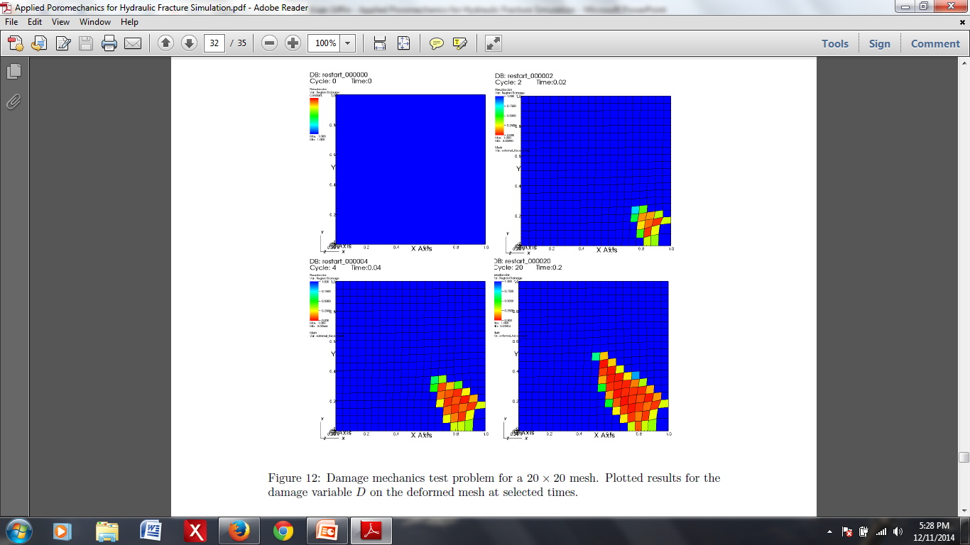
A Smeared-Crack Approach to Modeling Hydraulic Fracture in GEOS
Brian Giffin
under the advisement of Dr. Mark Rashid
and in collaboration with Dr. Randolph Settgast
February 13, 2015

Slide 2
Outline
Introduction & Approach
Poromechanics
Damage Mechanics
GEOS Implementation
Conclusions & Future Work

Slide 3
Introduction
Collaboration with LLNL
Interest in modeling hydraulic fracturing
GEOS: suitable platform for such problems
Main Goal: Implement a new modeling approach within GEOS

Slide 4
Approach
Homogenized (``Smeared’’) Approach for Modeling Hydraulic Fracture
Treat cracked rock mass as a homogenized medium
Variable and anisotropic stiffness and hydraulic conductivity
Evolve constitutive behavior via a damage parameter to simulate crack propagation
Eliminates the need for:
Re-meshing the geometry as `cracks’ evolve
Contact enforcement between cracked faces
The generation of a separate `flow mesh’

Slide 5
Poromechanics
Coupled solution of solid deformation and flow in a porous medium
Quasi-static deformation
Fully saturated, single phase, diffusive fluid flow
Consider a RVE to define the poroelastic solid

Slide 6
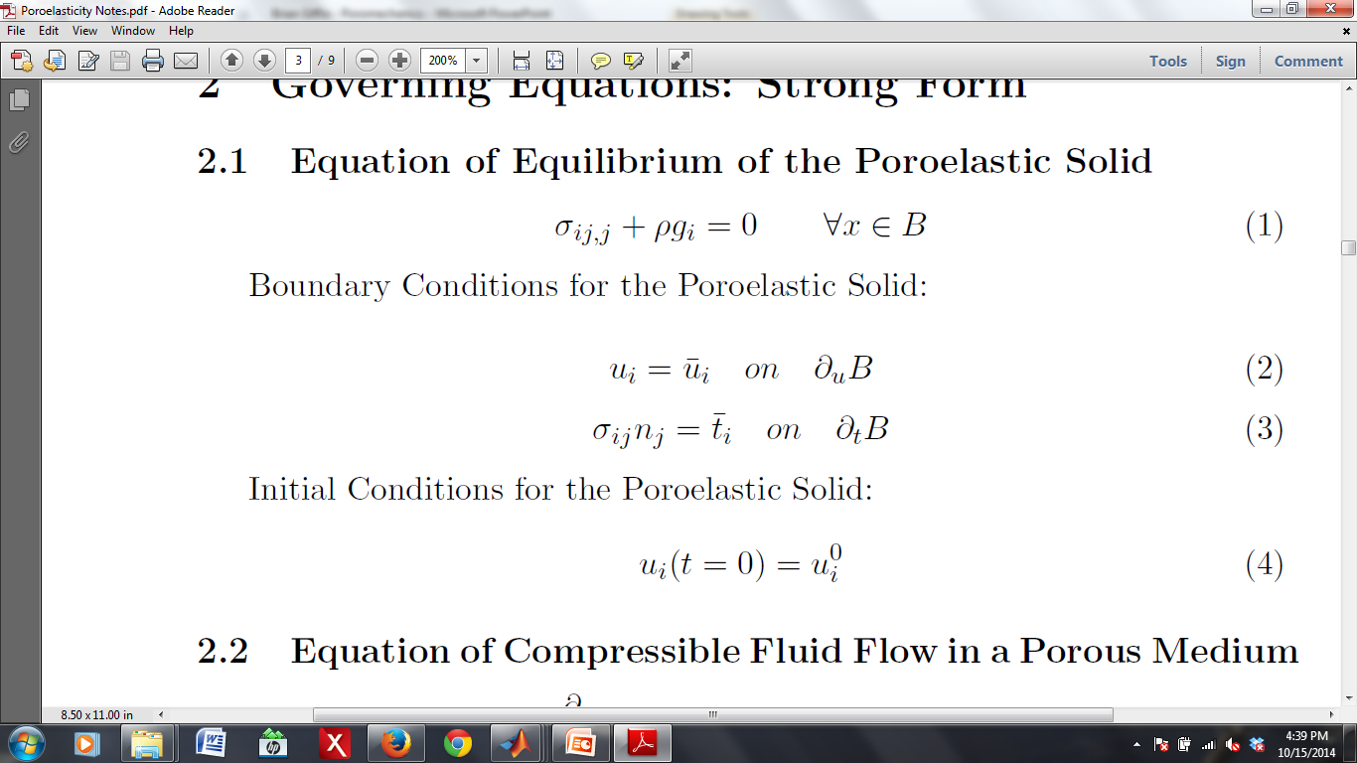
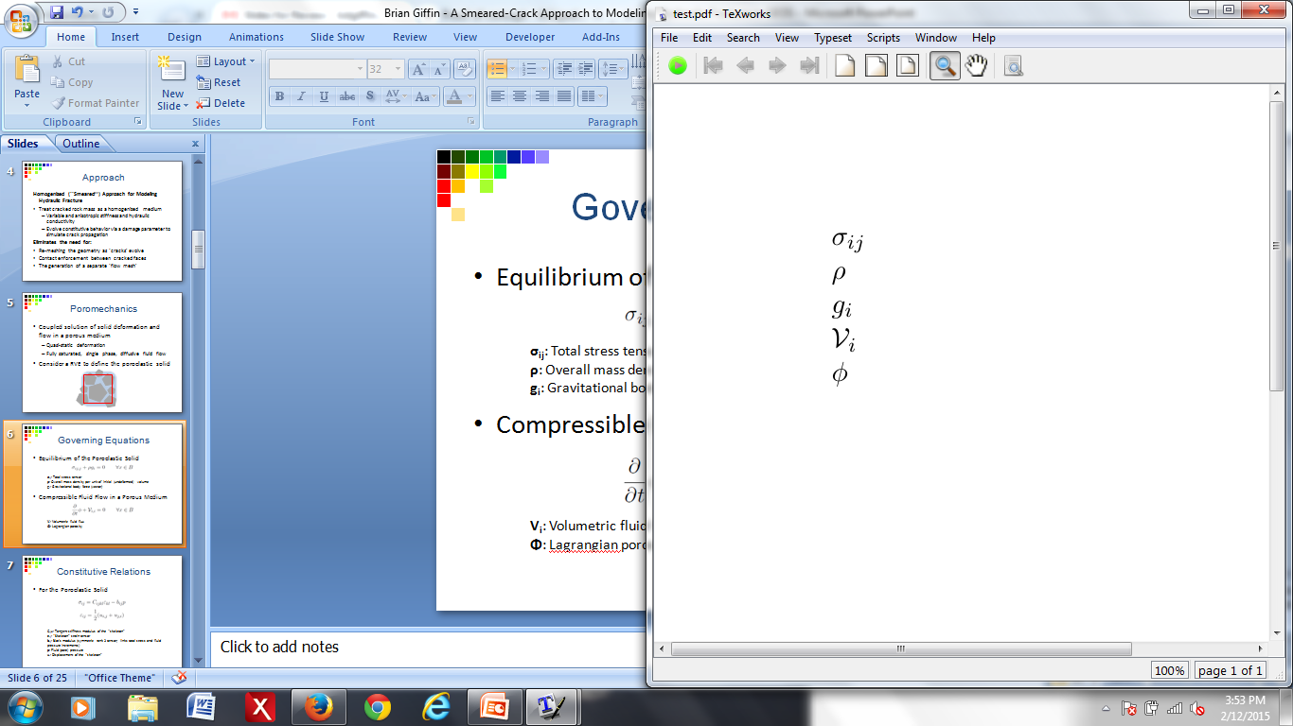
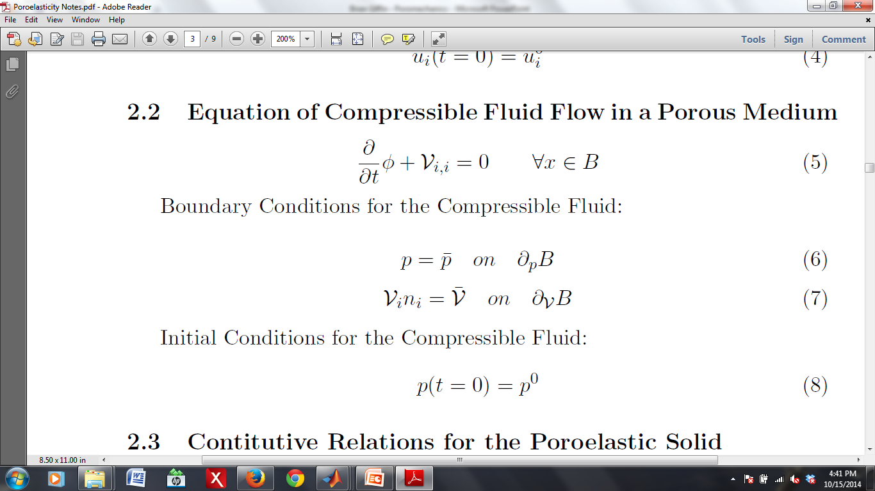
Governing Equations
Equilibrium of the Poroelastic Solid
Compressible Fluid Flow in a Porous Medium
Total stress tensor
Overall mass density per unit of initial (undeformed) volume
Gravitational body force (vector)
Volumetric fluid flux
Lagrangian porosity

Slide 7
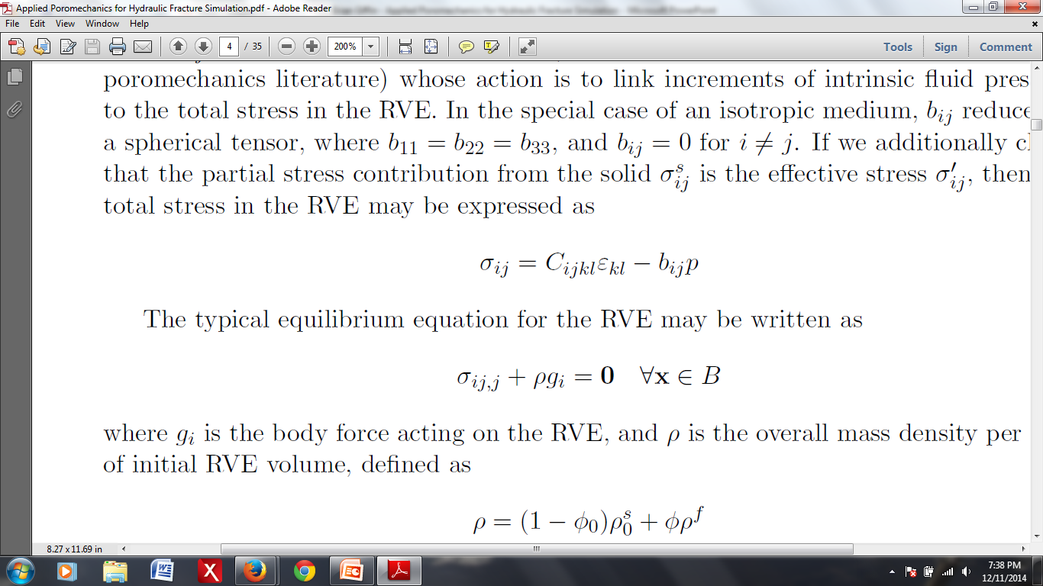
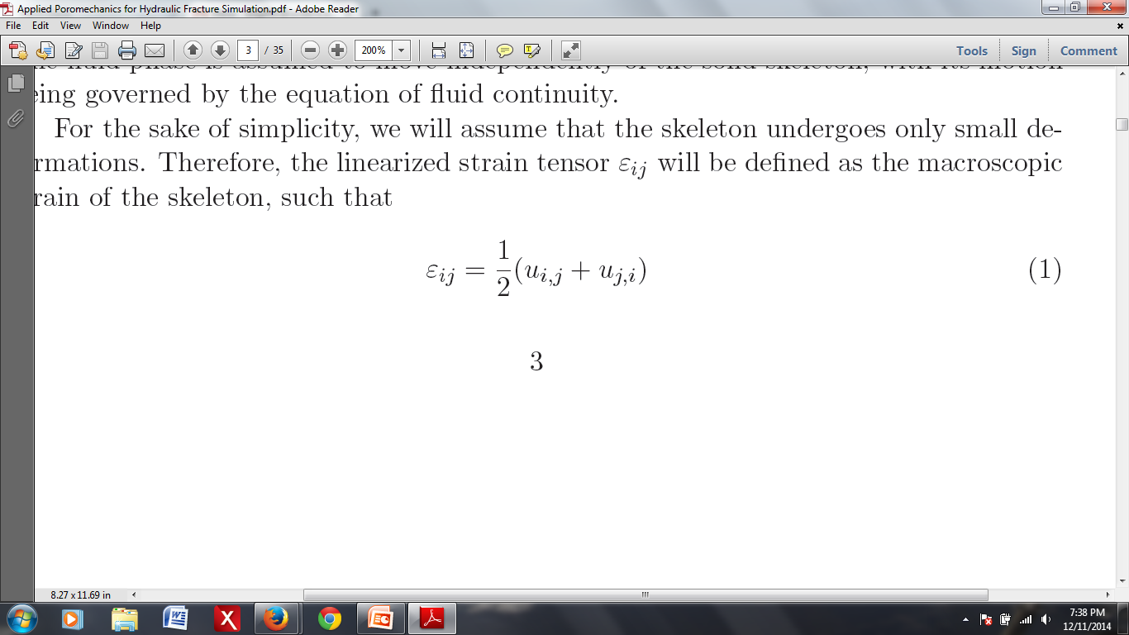
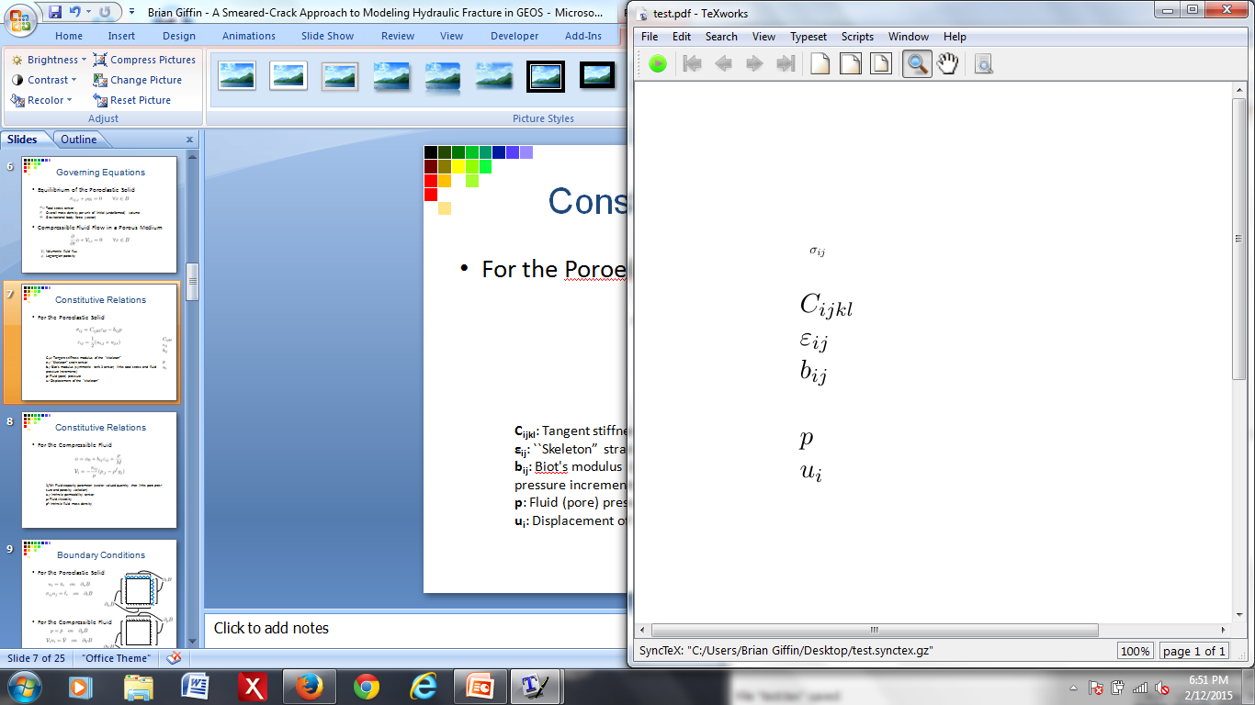
Constitutive Relations
For the Poroelastic Solid
Tangent stiffness modulus of the “skeleton”
``Skeleton” strain tensor
Biot's modulus (symmetric rank 2 tensor; links total stress and fluid
pressure increments)
Fluid (pore) pressure
Displacement of the ``skeleton”

Slide 8
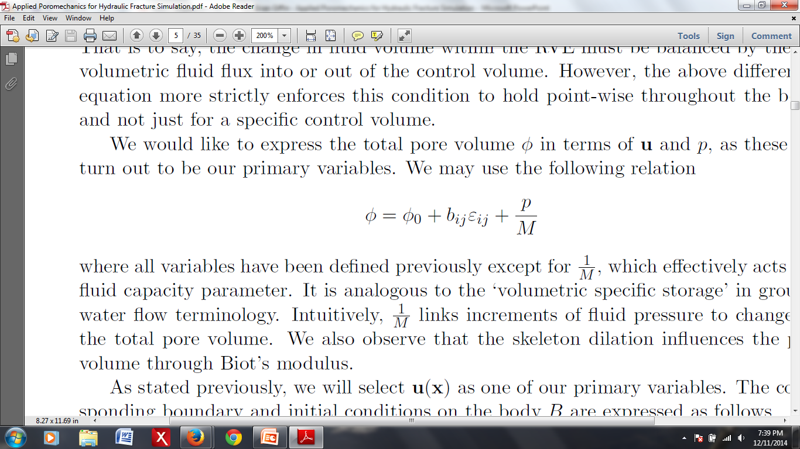
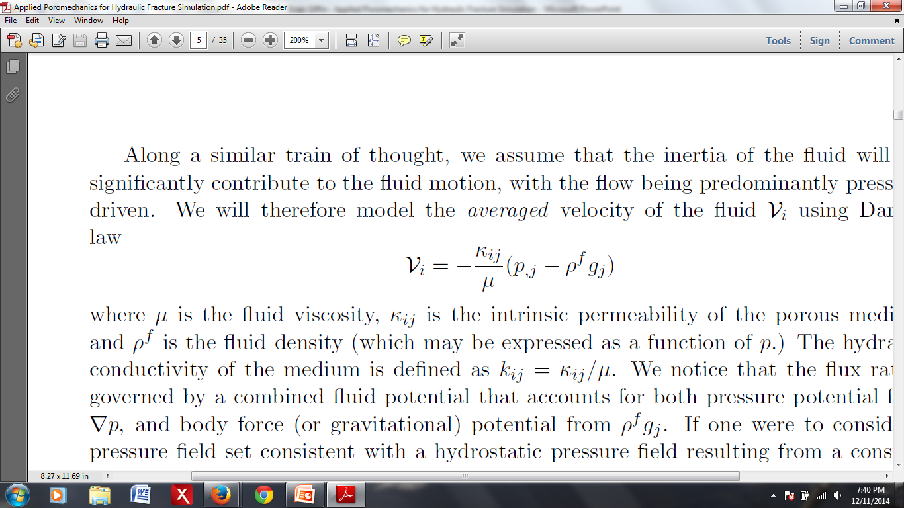
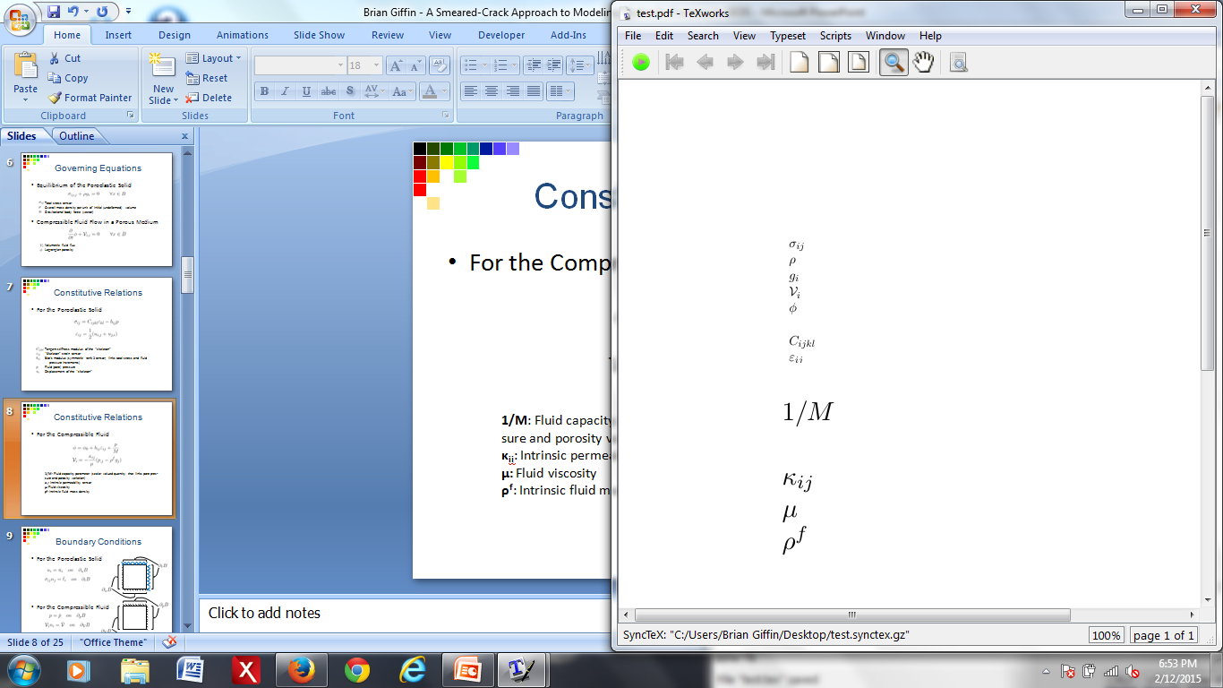
Constitutive Relations
For the Compressible Fluid
Fluid capacity parameter (scalar valued quantity that links pore
pressure and porosity variation)
Intrinsic permeability tensor
Fluid viscosity
Intrinsic fluid mass density

Slide 9
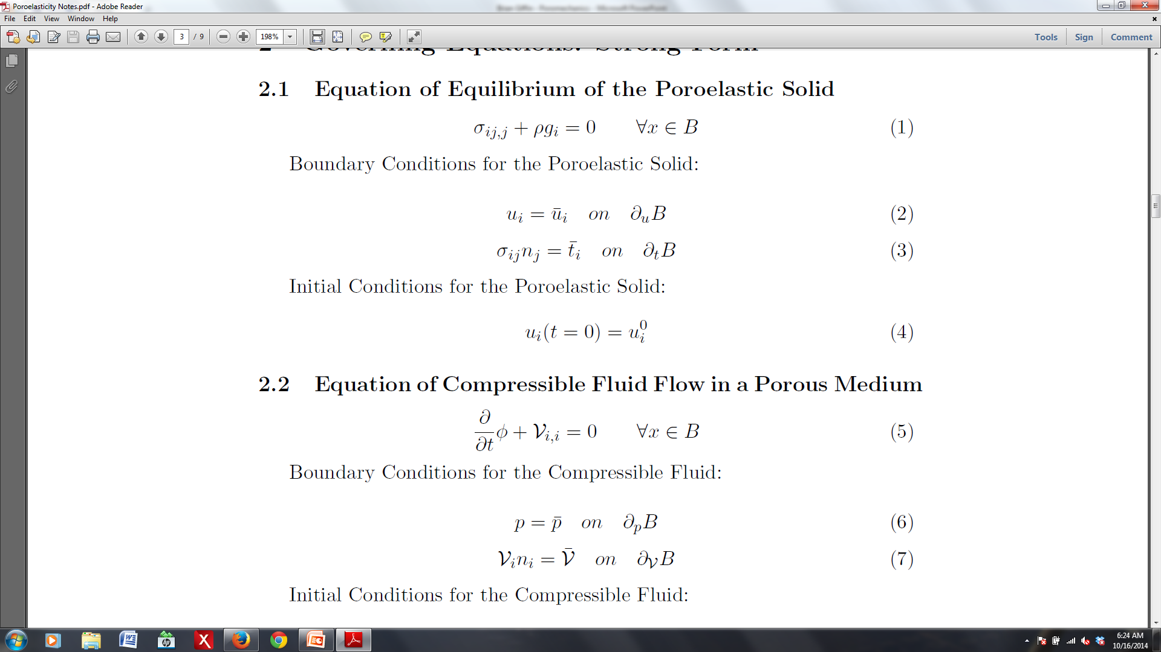
Boundary Conditions
For the Poroelastic Solid
For the Compressible Fluid

Slide 10
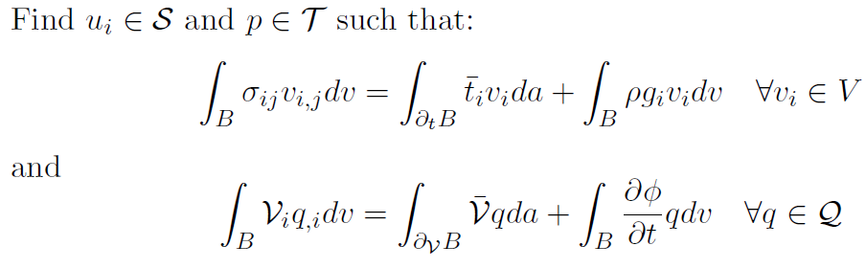
Weak Form

Slide 11
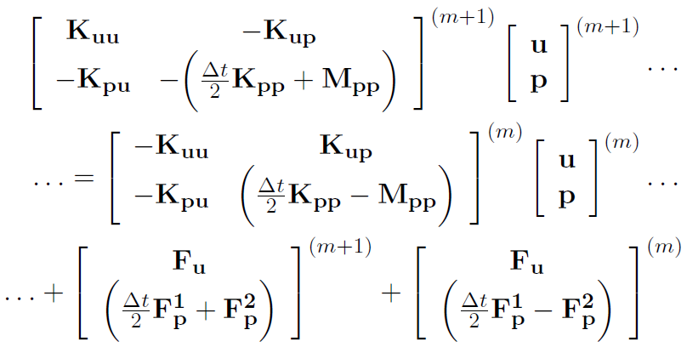
Finite Element System of Equations

Slide 12
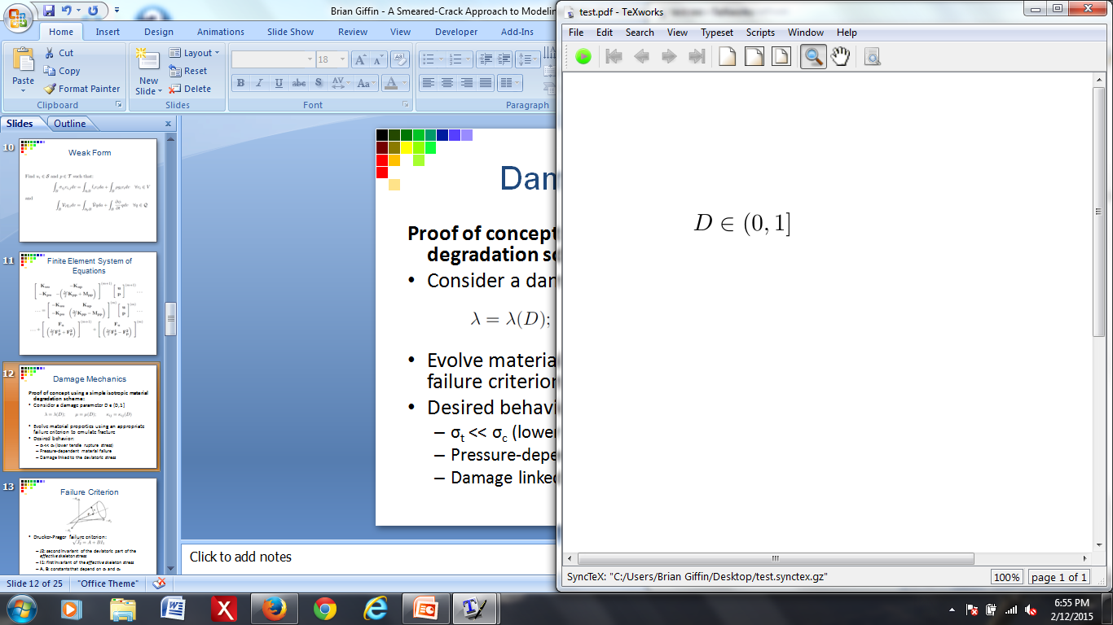
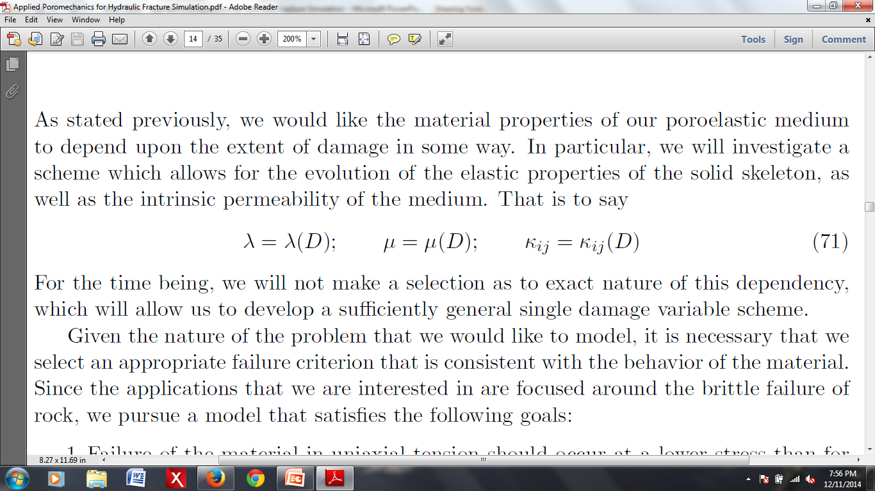
Damage Mechanics
Proof of concept using a simple isotropic material degradation scheme:
Consider a damage parameter:
Evolve material properties using an appropriate failure criterion to emulate fracture
Desired behavior:
σ_{t} << σ_{c} (lower tensile rupture stress)
Pressure-dependent material failure
Damage linked to the deviatoric stress

Slide 13
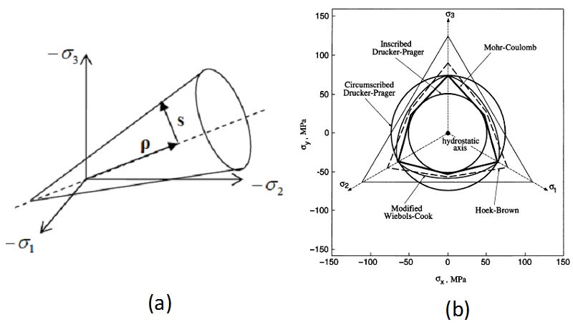
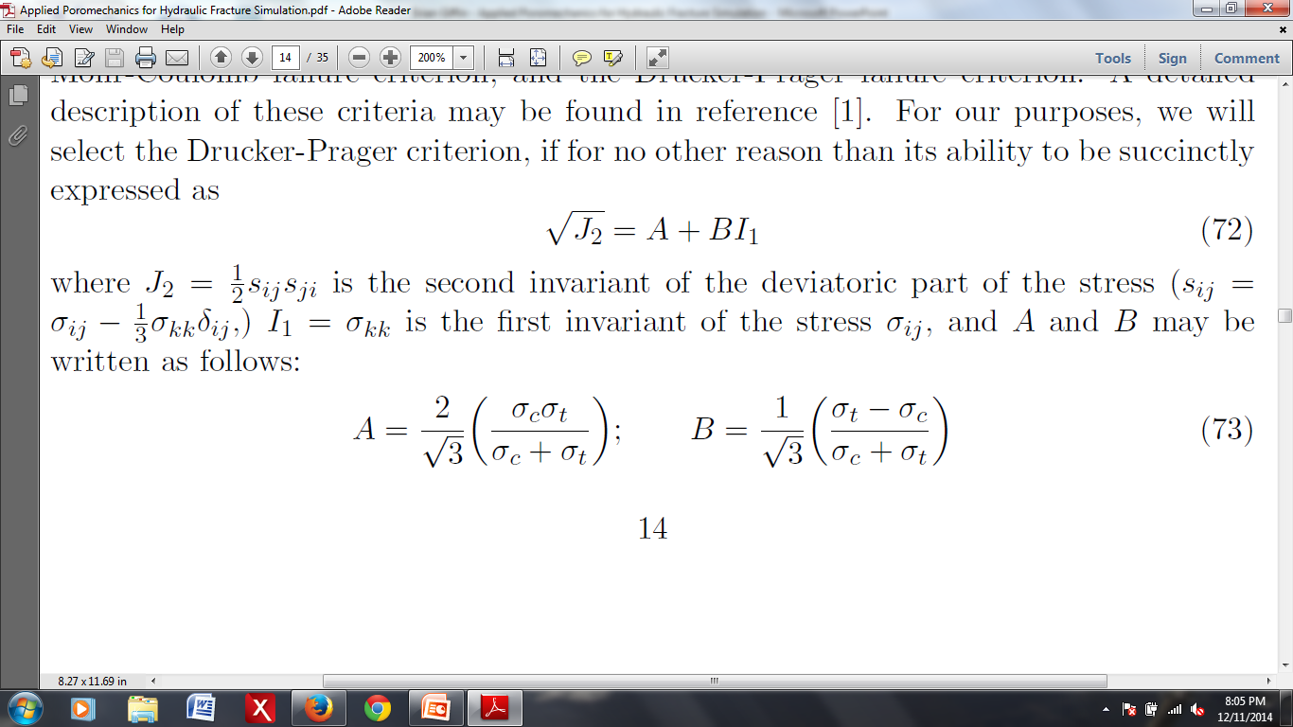
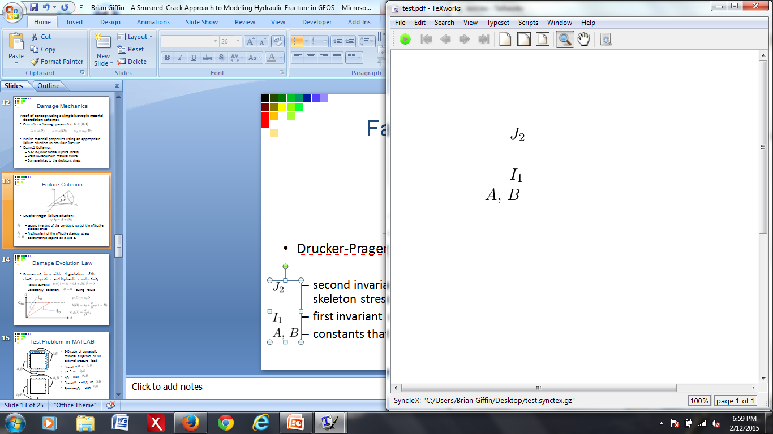
Failure Criterion
Drucker-Prager failure criterion:
second invariant of the deviatoric part of the effective skeleton stress
first invariant of the effective skeleton stress
constants that depend on σ_{t} and σ_{c}

Slide 14
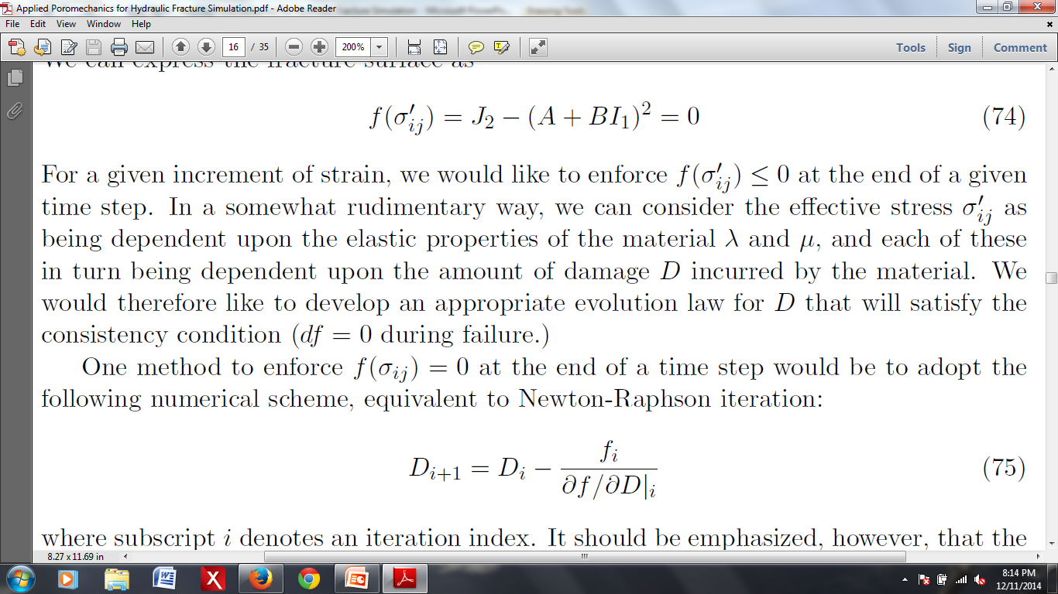

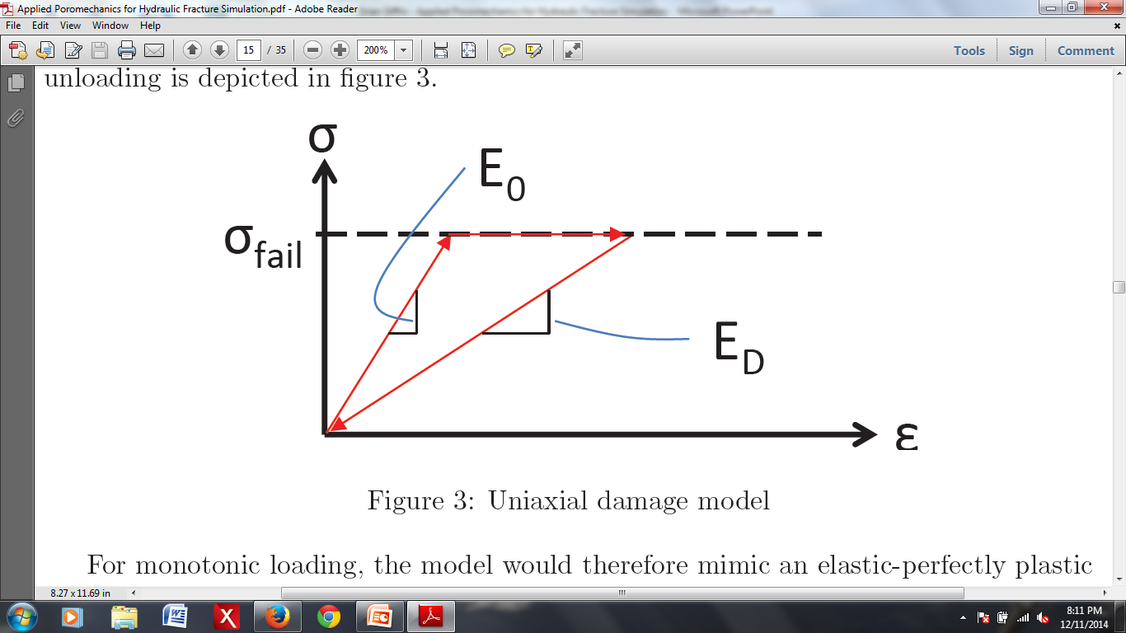
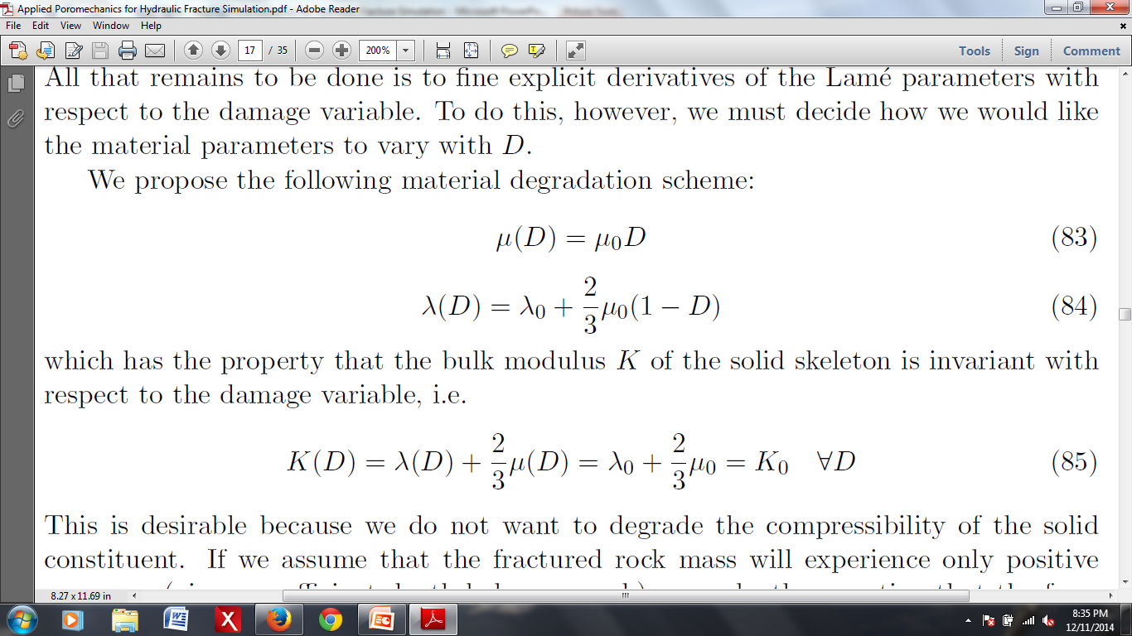
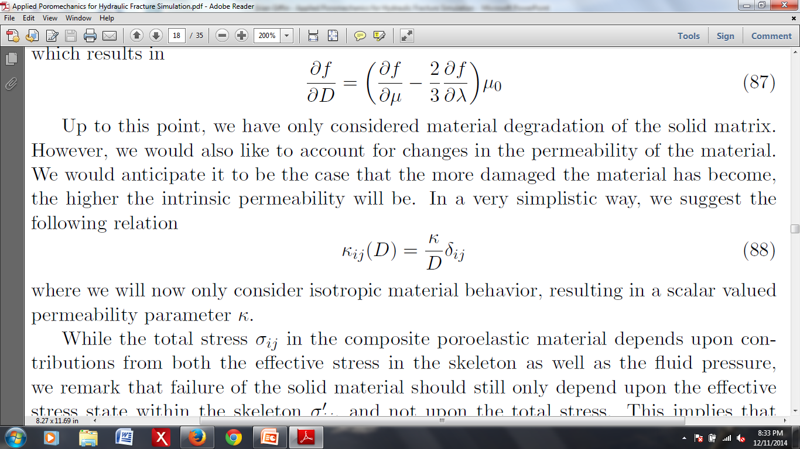
Damage Evolution Law
Permanent, irreversible degradation of the elastic properties and hydraulic conductivity:
Failure surface:
Consistency condition: during failure

Slide 15
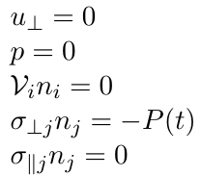
Test Problem in MATLAB
2-D cube of poroelastic material subjected to an external pressure load
on
on
on
on
on

Slide 16
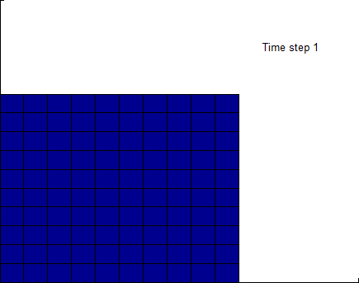
Test Problem 1
Material: homogeneous, isotropic, time invariant
P
t

Slide 17
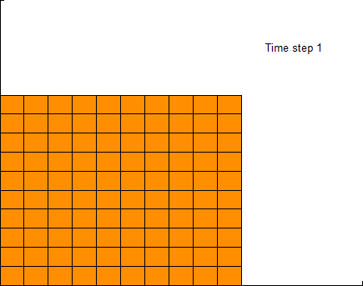
Test Problem 2
P(t) = constant
P
t

Slide 18
Pressure Oscillations
Known issue with coupled poromechanics
Occurs for:
Incompressibility constraint
Violation of minimum time step criterion
Can be overcome through mesh refinement
There exist several remediation techniques
Fluid pressure Laplacian stabilization (FPL)
Adds stabilization terms to the weak form

Slide 19
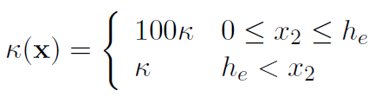
Test Problem 3
Inhomogeneous material properties

Slide 20
Implementation in GEOS
Code based around physics `solvers’
Different solvers model different physics
e.g. solid mechanics or fluid mechanics
Goal: create a `Poromechanics Solver’ that incorporates a rudimentary damage model

Slide 21
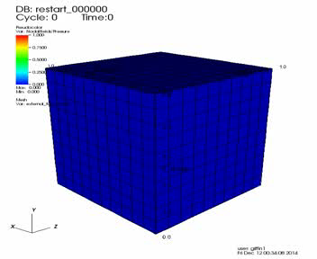
3D Test Problem
3D version of MATLAB Test Problem 1, using GEOS

Slide 22
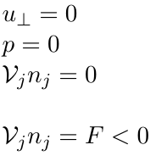
Pressure-Driven Damage Test
2D block of initially undamaged poroelastic material
on
on
on top, left, bottom faces of
on right face
(F < 0, inward directed)

Slide 23
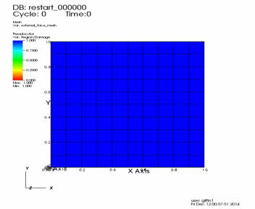
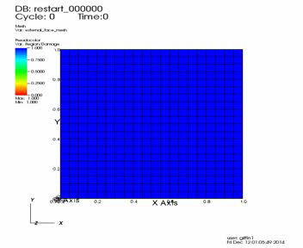
Depiction of Damage Evolution
10x10
20x20

Slide 24
Opportunities for Future Work
Differentiate between crack initiation and propagation
Would require proper identification of crack tips
Investigate anisotropic material degradation
Employ a more sophisticated damage evolution law
Look at plasticity models for granular materials
Nonlocal damage theories
Pursue methods for abating spurious pressure oscillations (FPL)
Implement dynamics and finite deformations
Consider multi-phase fluid flow
Investigate a double-porosity model to differentiate between crack porosity vs. rock porosity

Slide 25
Questions?

